Slide 1
Fitness Buddy – Ai companion
IBM AICTE PROJECT
Presented By:Sayandwip
Student name : Sayandwip Ghosh
College Name & Department :Narula Institute of Technology,Agarpara
Dept: Computer Science Engineering

Slide 2
OUTLINE
Problem Statement
Technology used
Wow factor
End users
Result
Conclusion
Git-hub Link
Future scope
IBM Certifications

Slide 3
Problem Statement
Many people struggle to maintain a consistent fitness routine due to a lack of motivation, proper guidance, and time to plan healthy meals. Without personalized support, they often skip workouts, follow unhealthy diets, and fail to meet their fitness goals. Access to on-demand fitness advice is usually limited or time-consuming.
Proposed Solution: Create an AI chatbot named Fitness Buddy that provides quick workout tips, healthy meal ideas, and daily motivation. It uses IBM Watson Assistant Lite on IBM Cloud Lite for instant and interactive support.

Slide 4
Technology used
IBM cloud lite services
Natural Language Processing (NLP)
Retrieval Augmented Generation (RAG)
AI that responds to user prompts in a conversational way
IBM Granite model

Slide 5
IBM cloud services used
IBM Cloud Watsonx AI Studio
IBM Cloud Watsonx AI runtime
IBM Cloud Agent Lab
IBM Granite foundation model

Slide 6
Wow factors
Fully implemented on the IBM Cloud Lite free tier with no upgrades required
Personalized – Suggests workouts and meals based on your goals.
Proactive – Reminds, motivates, and tracks your progress automatically.
Smart with RAG – Gives accurate fitness tips from a knowledge base.
Conversational – Chat like a real fitness coach.
Free & 24/7 – Runs on IBM Cloud Lite, always available.
Motivating – Builds habits with reminders and streaks.

Slide 7
End users
Fitness lovers and beginners can easy .
Busy students and professionals can use.
Health coaches can use as support tool.
Anyone wanting motivation for a healthy life

Slide 8
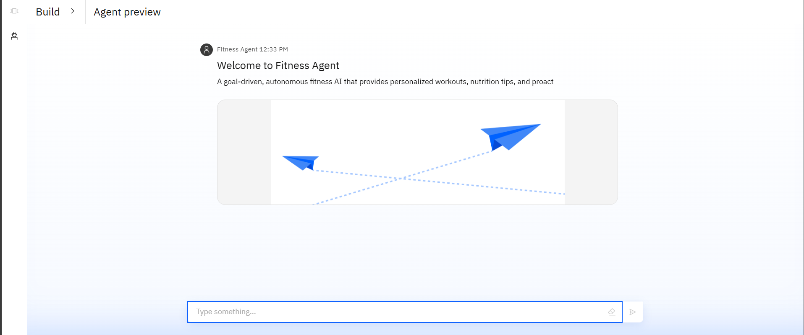
Results

Slide 9
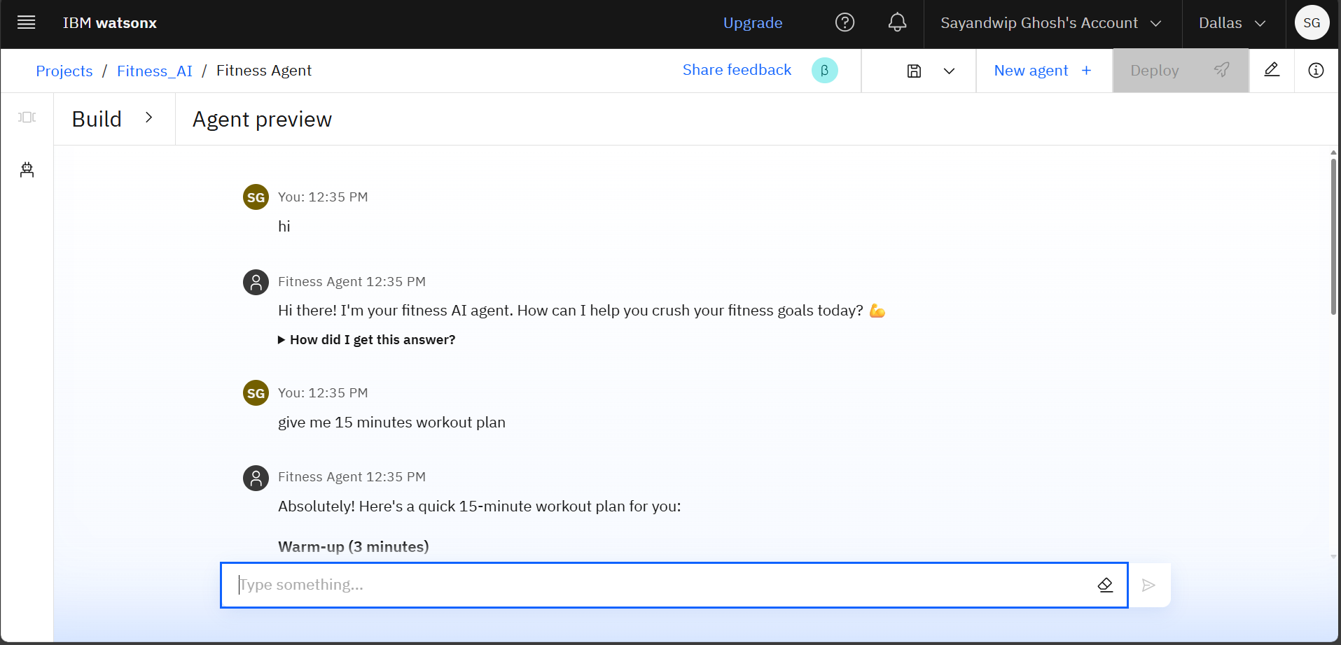
Results

Slide 10
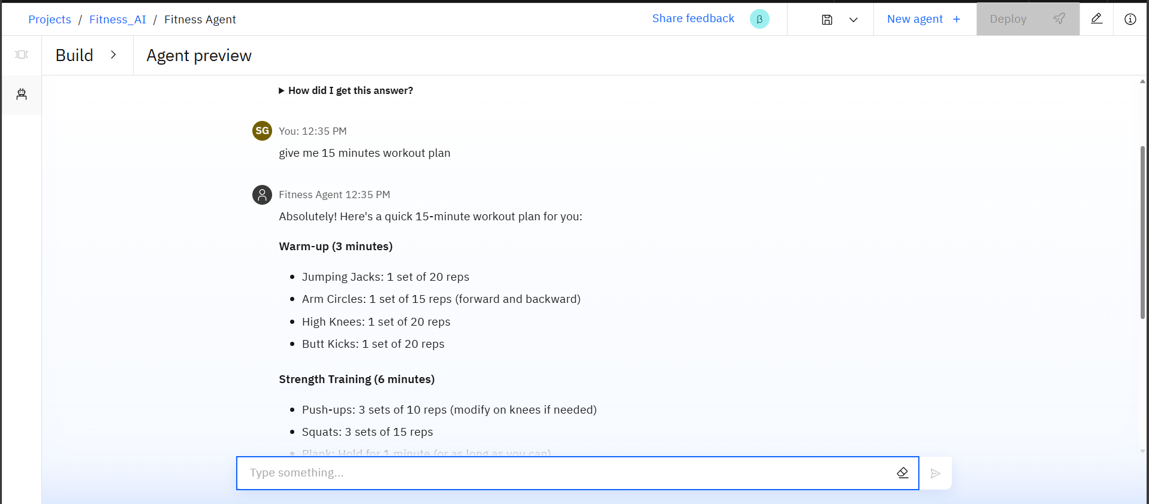
Results

Slide 11
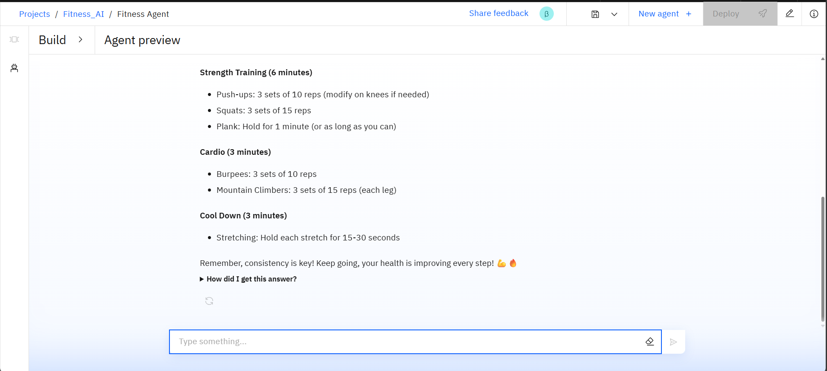
Results

Slide 12
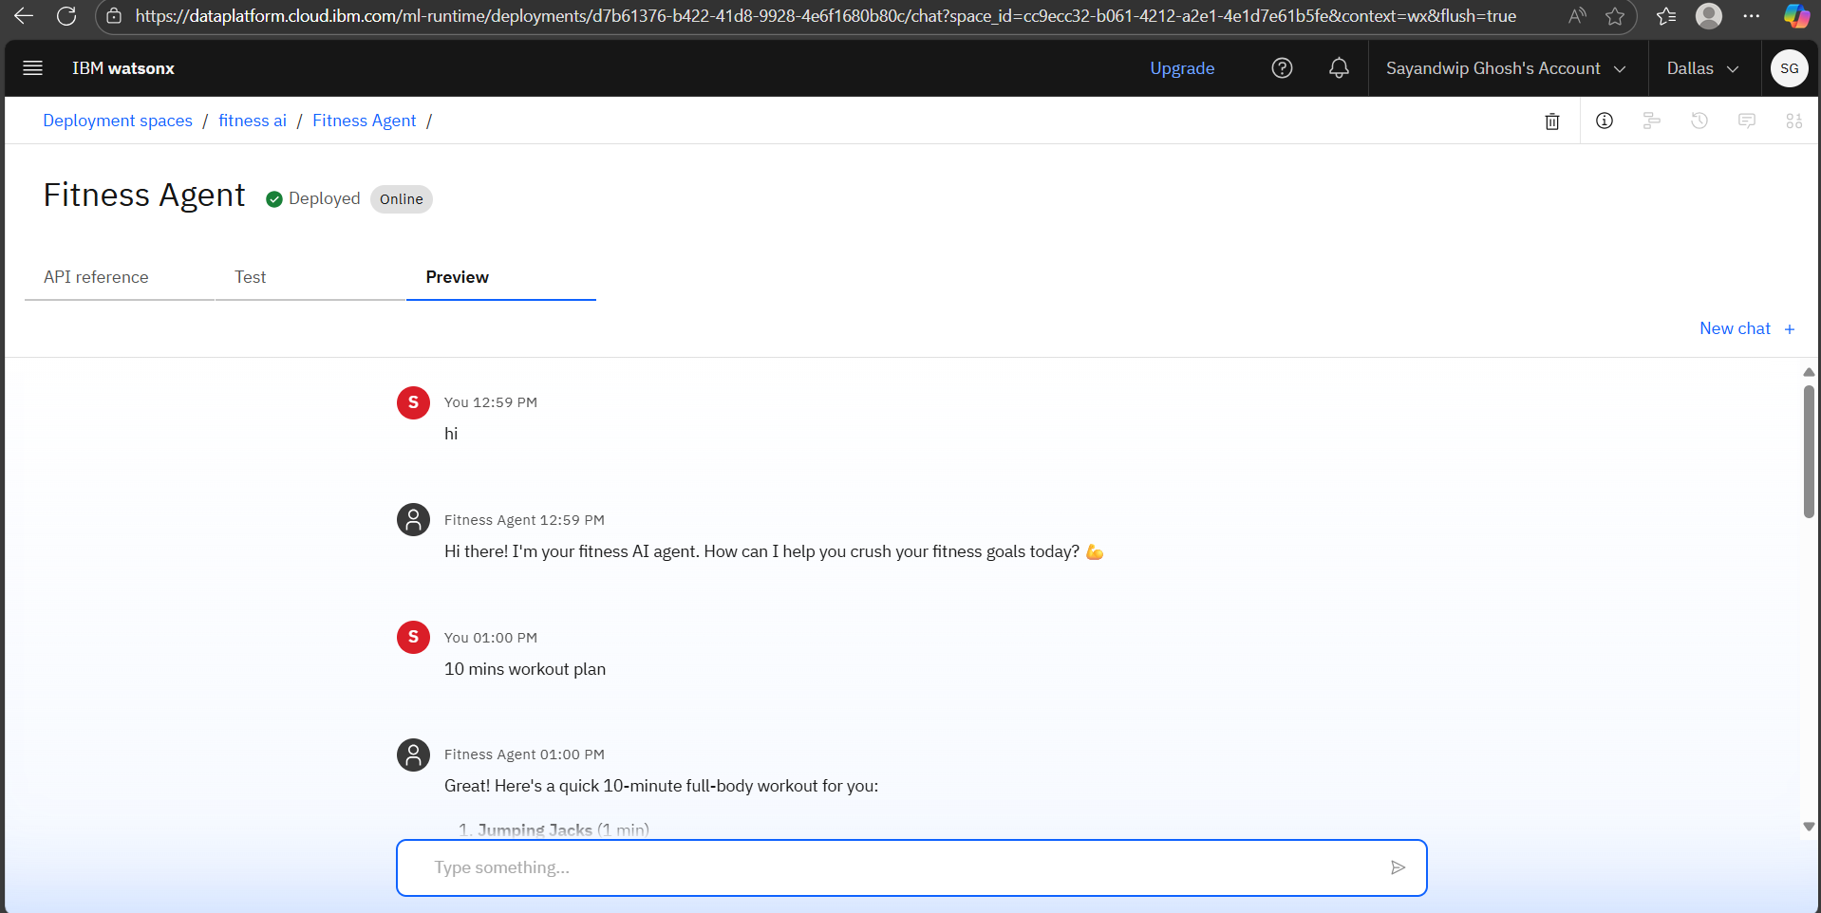
Results
Deployed AI Agent

Slide 13
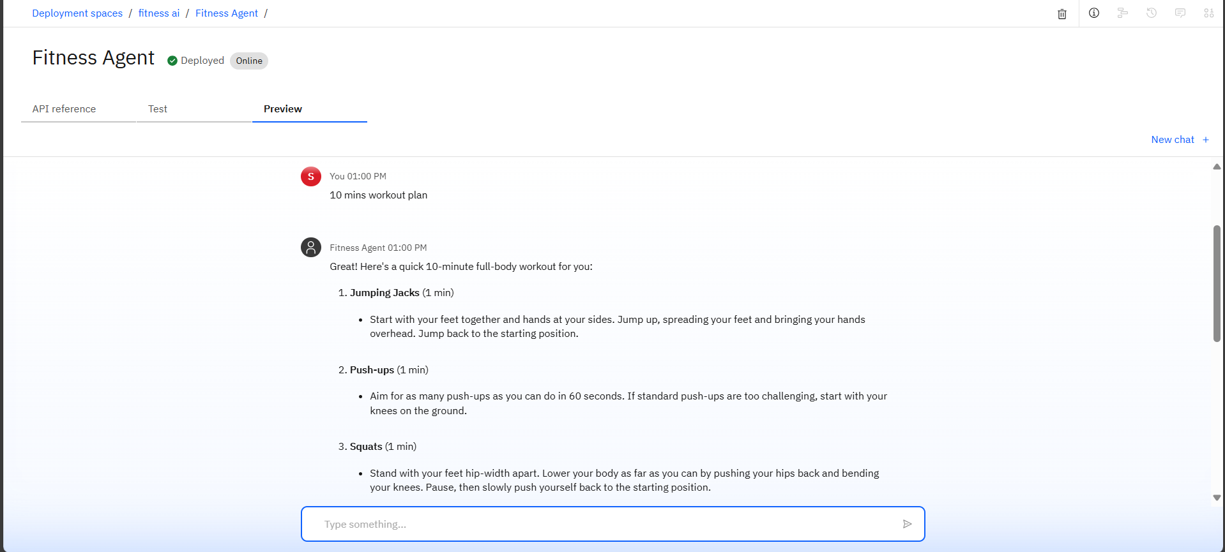
Results
Deployed AI Agent

Slide 14
Conclusion
Fitness Buddy is an AI health coach built on IBM Cloud Lite. It offers free, easy-to-access fitness tips, workout suggestions, and motivation. Using prompt-based AI, it creates smooth conversations and helps anyone stay healthy without extra cost.

Slide 15
GitHub Link

Slide 16
Future scope
Extend with user profile tracking for personalized plans
Add voice interaction through IBM Watson Speech-to-Text and Text-to-Speech
Integrate with wearable fitness devices for real-time feedback
Expand to multi-language support for diverse users
Enhance with RAG-based knowledge retrieval for richer contextual advice

Slide 17
IBM Certifications

Slide 18
IBM Certifications

Slide 19
IBM Certifications

Slide 20
THANK YOU

